Slide 1
Python Pandas - Advanced

Slide 2
Agenda
Concatenate and Join data frames (Pre-requisite)
Merge data frames
Reshape
Pivot Tables and Cross Tables
Check for Duplicates
Dropping Rows and Columns
Mapping and Replacing
Group the Dataframe
Summary Statistics and Skewness/Kurtosis
Data Visualization using Matplotlib library

Slide 3
Concatenate the DataFrames
A Pandas DataFrame is a two dimensional size-mutable, heterogeneous data structure with labeled rows and columns
DataFrames can be concatenated vertically (column-wise) and horizontally (row-wise)
The concat() and append() methods are used to concatenate the DataFrames

Slide 4
Join the DataFrames
The join() method join the DataFrames based on index or key column
Index of the first DataFrame should match to one of the column in the second DataFrame

Slide 5
Merge the DataFrames

Slide 6
Merge the DataFrames
The merge() method concatenates the DataFrames based on one or more keys
If the column for join is not specified, the merge() method uses the overlapping column names as the keys

Slide 7
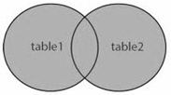
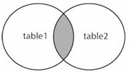
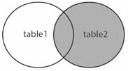
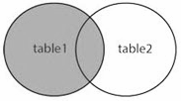
Types of merge
The merge types can be specified using the parameter, ‘how’
how = ‘Type’ | Description
outer | Use union of keys observed in both DataFrames
inner | Use intersection of keys observed in both DataFrames
right | Use only the keys found in the right DataFrame
left | Use only the keys found in the left DataFrame
If the type is not specified, by default it is ‘inner’

Slide 8
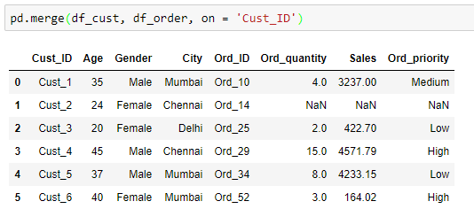
Inner merge
Merge both the DataFrames on common customer IDs
Merge on ‘Cust_ID’
Merge includes the common IDs in both the DataFrames
NaNs are printed where order details are not available

Slide 9
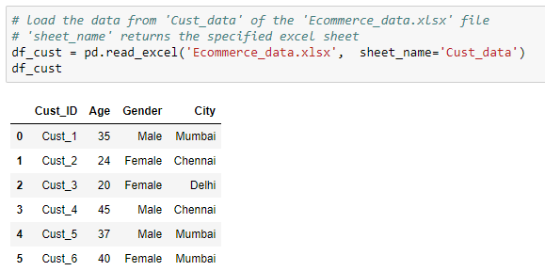
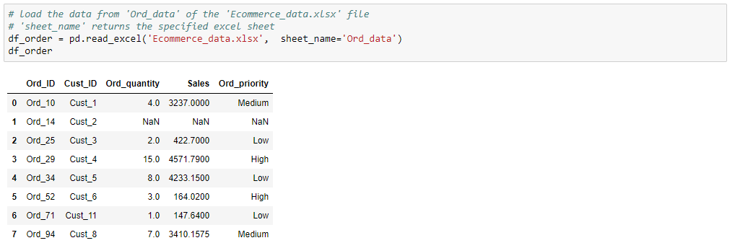
Read the DataFrames
Use the following DataFrames for further manipulations:
Customer details
Order details

Slide 10
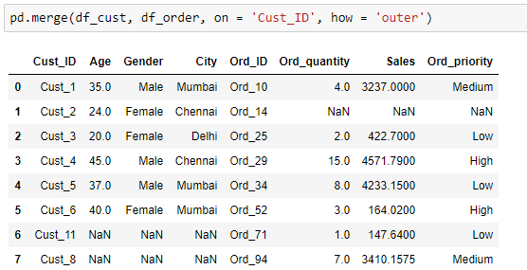
Outer merge
Merge on ‘Cust_ID’
Outer merge includes the IDs in both DataFrames
NaNs are printed where order details are not available
NaNs are printed where customer details are not available

Slide 11
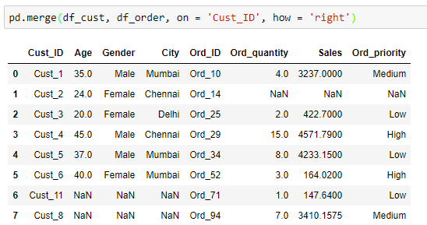
Right merge
Merge on ‘Cust_ID’
Merge includes all the IDs in ‘df_order’
NaNs are printed where order details are not available
NaNs are printed where customer details are not available

Slide 12
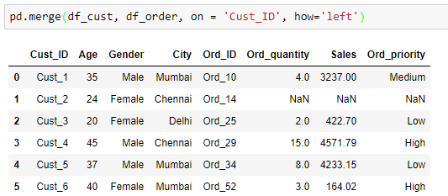
Left merge
Merge on ‘Cust_ID’
Merge includes all the IDs in ‘df_cust’
NaNs are printed where order details are not available

Slide 13
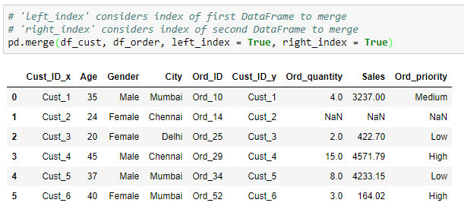
Merge using index
Merged DataFrame has the number of rows equal to that of the minimum of both the DataFrames. It includes rows from both DataFrames having same index
This method is useful, only if the record have same index in both the DataFrames

Slide 14
Merge vs. Join
Merge | Join
Joins one or more columns of the second DataFrame | Joins by the index of the second DataFrame
By default, performs ‘inner’ merge | By default, performs ‘Left’ join
Returns error if one tries to merge more than two DataFrames simultaneously | Joins multiple DataFrames by index

Slide 15
Reshape

Slide 16
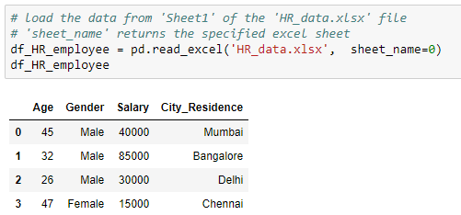
Read the DataFrames
Use the following DataFrame for further manipulations:

Slide 17
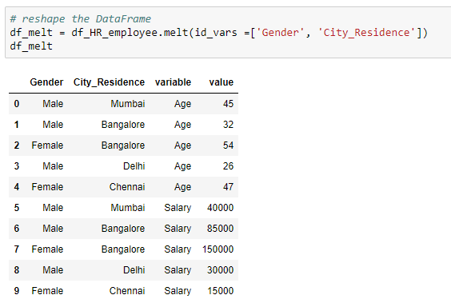
Reshape
The melt() method is used to change the DataFrame format from wide to long
The column ‘variable’ contains all the columns except the identifiers and ‘value’ contains the values of corresponding column
Pass list of columns as identifiers

Slide 18
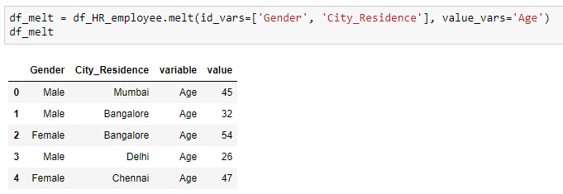
Reshape
Assign the variables to the parameter, ‘value_vars’ to get the corresponding values for specified identifiers
Pass the column names to return the corresponding values

Slide 19
Pivot Tables

Slide 20
Pivot tables
It has a DataFrame like structure
It is used to display the data for the specified columns and index

Slide 21
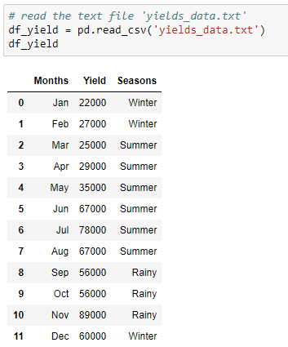
Read the DataFrame
Use the following DataFrame to create a pivot table

Slide 22
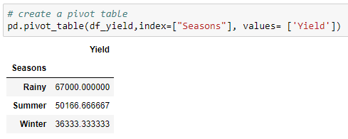
Create a pivot table
The pivot_table() method generates a pivot table for the given index
By default, the aggregate function is ‘mean’, which aggregates the columns passed in the parameter, ‘values’
Pass the columns to aggregate
Average yield per season

Slide 23
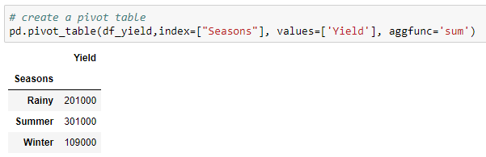
Create a pivot table
Returns the sum of values
Sum of yield per season

Slide 24
Cross Tables

Slide 25
Cross tables
Cross tables are similar to pivot tables
It computes a cross tabulation of two or more factors

Slide 26
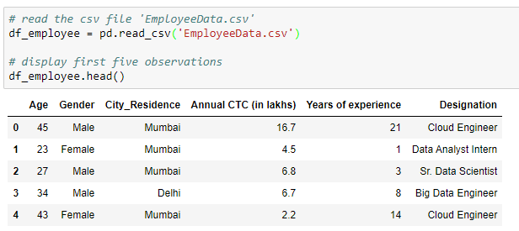
Read the DataFrame
Read the csv file ‘EmployeeData’ and print the first five observations

Slide 27
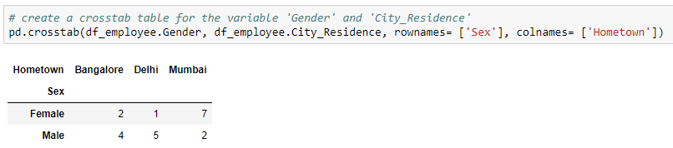
Create a cross table
Find the city-wise gender count using the crosstab() method
Add the row label
Add the column label
By default, the crosstab() method returns the frequency table of the variables

Slide 28
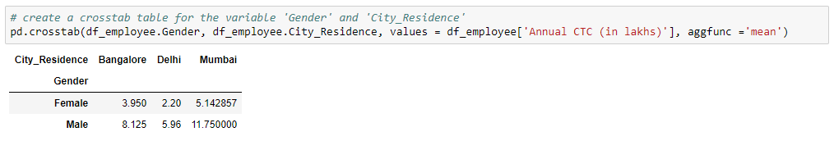
Create a cross table
Find the city-wise distribution of salary for different genders
Values to be aggregated
Function to aggregate the values
Gender and city-wise
Average salary

Slide 29
Check for duplicates

Slide 30
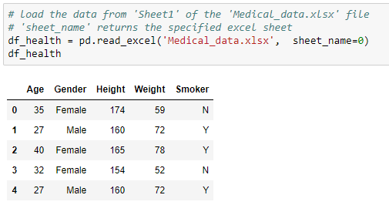
Read the DataFrames
Use the below DataFrame for further manipulations:

Slide 31
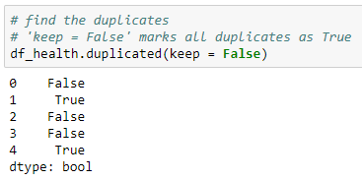
Check for duplicates
Check the duplicate observations using the duplicated() method
The second and last observation in the dataset is same

Slide 32
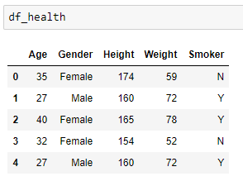
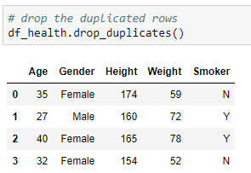
Drop duplicates
Use the drop_duplicates() method to drop the duplicated rows
Before
After

Slide 33
Dropping Rows and Columns

Slide 34
Drop the rows and columns
The drop() method is used to drop the unwanted rows and columns from the data
There are scenarios where we need to drop certain rows and/or columns which have missing values, or are redundant with respect to our analysis

Slide 35
Read the DataFrame
Read the csv file ‘EmployeeData’ and print the first five observations

Slide 36
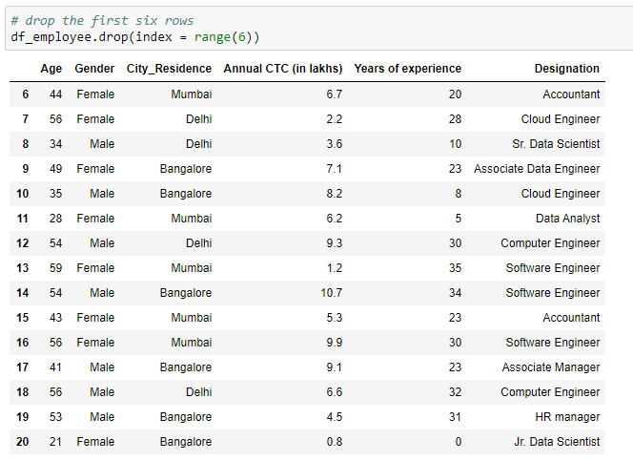
Drop the rows
Pass the row indices to ‘index’
Use drop() method to drop the rows with index values
Here ‘range(6)’ is used to drop the first six rows

Slide 37
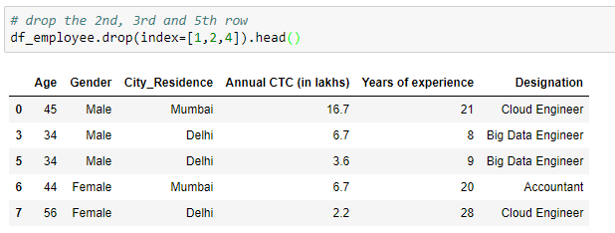
Drop the rows
Pass the list of row indices to drop the rows

Slide 38
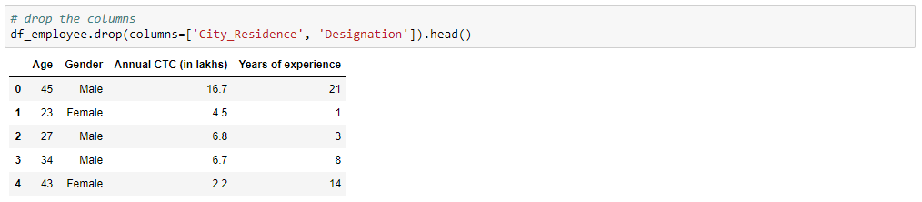
Drop the columns
Pass the list of column names to drop the columns

Slide 39
Usage of inplace
We saw how to drop the unwanted rows and column
However, doing so does not delete it permanently
To remove them permanently from the data, we use the parameter ‘inplace’ and set it to true
By default, the value inplace takes is false

Slide 40
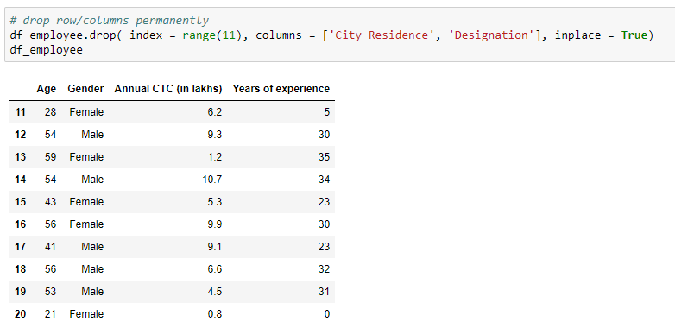
Usage of inplace
Drop the the first 11 rows and the variables ‘City_Residence’ and ‘Designation’
Removes the rows and columns from the original data

Slide 41
Mapping and Replacing

Slide 42
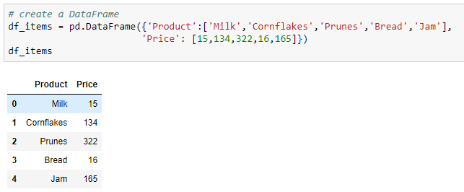
Create a DataFrame
Use the below DataFrame for further manipulations:

Slide 43
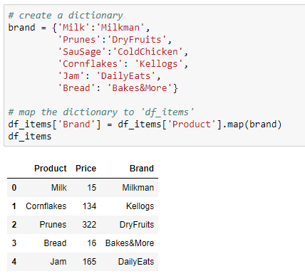
Map the dictionary
Use the map() method to create a new column by mapping the DataFrame column values with the dictionary key
Map the dictionary to create a new column

Slide 44
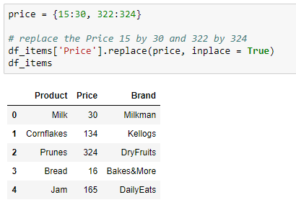
Replace the values
The replace() method is used to replace the values in the DataFrame
Create a dictionary to replace the values

Slide 45
Group the DataFrame

Slide 46
Create a DataFrame
Use the following DataFrame for further manipulations:

Slide 47
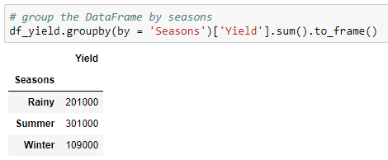
Group the DataFrame
Use groupby() method to group the dataframe by the specific column(s)
Converts the series to DataFrame
Group the data by ‘Seasons’
Add the values for each season

Slide 48
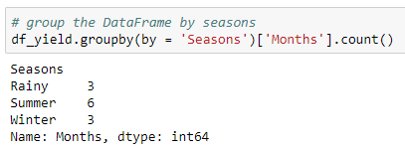
Group the DataFrame
Get the number of months for each season
Returns the number of months per season
Output as a series

Slide 49
Visualization using Matplotlib

Slide 50
Data visualization
Representation of the data in a pictorial or graphical format
First step of data analysis
Allow us to get the intuitive understanding of the data
Helps to visualize the patterns in the data

Slide 51
Introduction to matplotlib
It is a Python’s 2D plotting library
‘pyplot’ is a subpackage of matplotlib that provides a MATLAB-like way of plotting
Provides a simple way of plotting the various plots like histogram, bar plot, scatter plot

Slide 52
Installation
Open terminal program (for Mac user) or command line (for Windows) and install the matplotlib using the command:
conda install matplotlib
Or
pip install matplotlib

Slide 53
Installation
Alternatively, you can install matplotlib in a jupyter notebook using below code:
!pip install matplotlib
To import subpackage ‘pyplot’, use the command:
import matplotlib.pyplot as plt

Slide 54
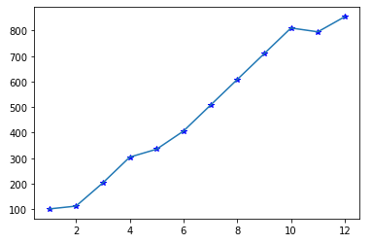
Line plot
It is a simple plot that displays the relationship between two variables

Slide 55
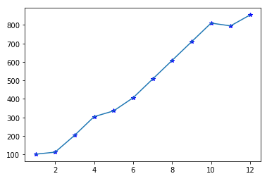
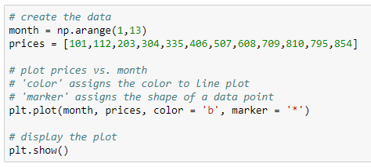
Plot a line plot from a list
Plot a line plot to visualize the price trend of a product over a year
Plot the line plot using the plot() method

Slide 56
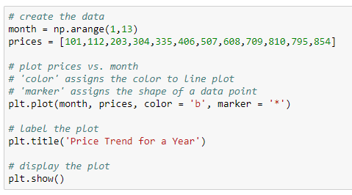
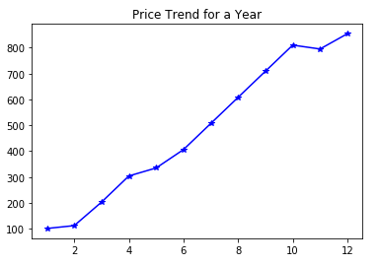
Add title of the graph
Put a title to the plot

Slide 57
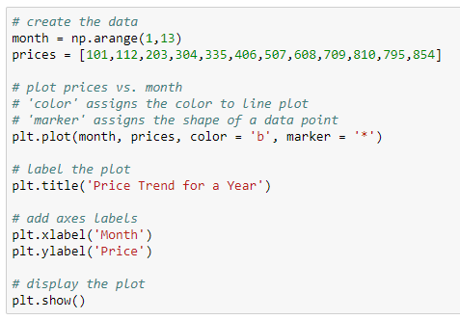
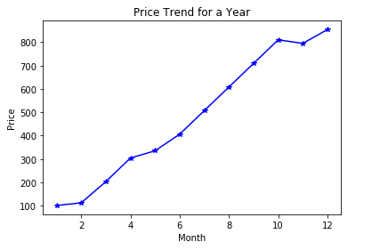
Add axes labels
Add labels to x and y axis

Slide 58
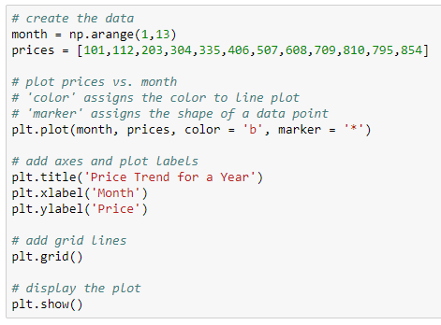
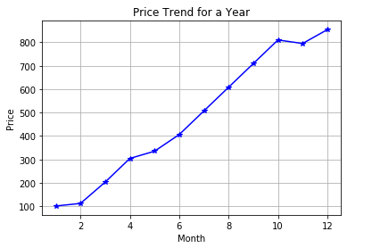
Add grid lines to the plot
Add grid lines

Slide 59
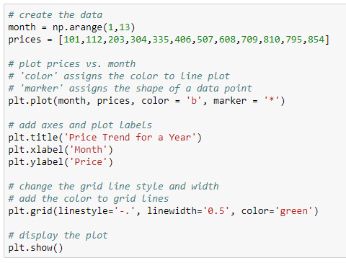
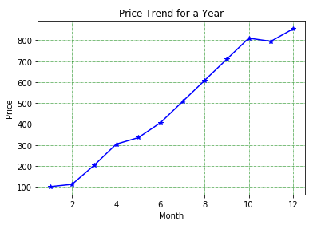
Customize the grid lines
Change style, width and color of grid lines

Slide 60
Multiple line plots
Plot the multiple line plots to represent the sales of each company recorded on the four different days. Use the data below to plot a graph:
Day | Sales
 | Vivo | Oppo | Samsung | Micromax
Day1 | 80000 | 75000 | 45000 | 47000
Day2 | 78000 | 44000 | 45000 | 55000
Day3 | 87000 | 58000 | 60333 | 78000
Day4 | 95000 | 40888 | 54000 | 65700

Slide 61
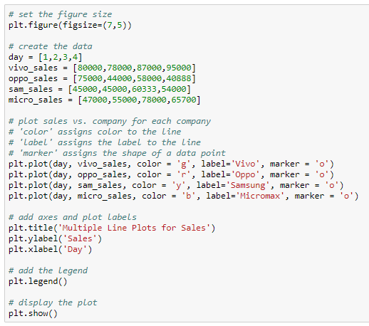
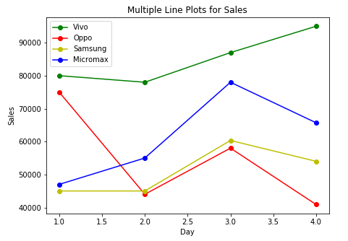
Multiple line plots
Each line represents the sales of a company for four days
Set the plot size
Plot multiple line plots

Slide 62
Scatter plot
It is used to display the relationship between two numeric variables
Used to represent the extent of correlation between two variables
Used to detect the extreme points in the data

Slide 63
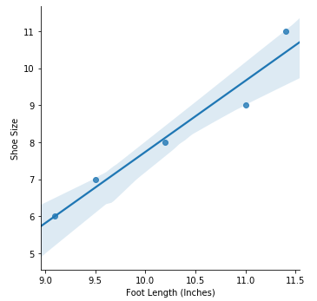
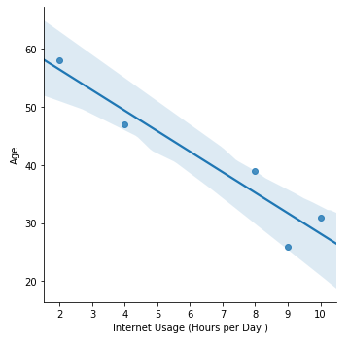
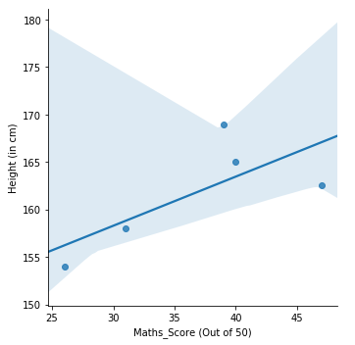
Scatter plot
Scatter plots explaining the different types of correlation between the variables:
Positive Correlation
( 𝜌 = 0.97167252 )
Negative Correlation
( 𝜌 = -0.95056151 )
No Correlation
( 𝜌 = 0.09919779 )

Slide 64
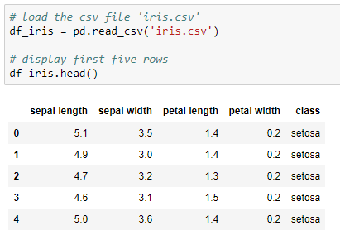
Read the data
Use the iris data to create the scatter plot

Slide 65


Scatter plot
Use the scatter() method to create scatter plot in matplotlib
Set the variables on x and y axis
There is no significant correlation between ‘sepal length’ and ‘sepal width’

Slide 66


Multiple scatter plots
Add the legend
The plot shows the positive relationship between ‘sepal length’ and ‘petal length’

Slide 67
Bar plot
It is used to display the categorical data with bars of lengths proportional to the values that they represent
Used to compare the different categories of the categorical variable
One axis displays the categorical variable and another displays the value for each category

Slide 68


Bar plot
The bar displays the bill amount by customer
Returns a vertical bar plot

Slide 69


Horizontal bar plot
Plot the chart horizontally using the barh() method
Returns a horizontal bar plot

Slide 70


Grouped bar plot
Compare the marks of the students in R and Python
Plot the bar plot for each subject

Slide 71


Stacked bar plot
Plot the ‘R_marks’ above the ‘Python_marks’

Slide 72
Pie plot
It is a circular graph divided into sections displaying the numeric proportion
It is used to display the univariate data
Each section of the pie plot represents a single category in the data

Slide 73


Pie plot
Plot a pie plot to study the population proportion for different countries
Add the percentage with value to tenth place

Slide 74


Exploded pie plot
It is a type of pie plot in which one or more sectors are separated from the disc
Explode the country with highest population

Slide 75


Donut pie plot
It is a type of pie plot with a hollow center representing a doughnut
Add circle to current figure

Slide 76
Histogram
It is used to represent the distribution of the numeric variable
It is an estimate of the probability distribution of a continuous data
One axis represents the variable in the form of bars and another represents the frequency each bar
There are no gaps between the bars of the histogram

Slide 77
Read the data
Use the iris data to create the histogram

Slide 78


Histogram
Plot the histogram to check the distribution of the variable, ‘sepal width’
Approximately 3 - 3.2 cm is the most occuring sepal width in the data

Slide 79


Histogram
Plot a histogram with 5 bins (bars)
‘bins’ returns a histogram with specified number of bars

Slide 80


Create multiple histograms
Number of rows and columns to plot the subplots
X-axis ticks are same for all subplots
Y-axis ticks are different for all subplots

Slide 81

Box plot
It is used to visualize the distribution of the numeric variable
Represents the five number summary of the variable which includes the minimum, first quartile (Q1), second quartile (median), third quartile (Q3) and maximum of the variable
Used to detect the outliers (extreme values) in the data

Slide 82
Read the data
Use the iris data to create the box plot

Slide 83


Box plot
Check the distribution of the variable ‘petal length’
median
The box plot shows that the variable ‘petal length’ is negatively skewed

Slide 84


Horizontal box plot
Check the distribution of the variable ‘petal length’
Returns the horizontal box plot
median
The box plot shows that the variable ‘petal length’ is negatively skewed

Slide 85


Add five number summary to box plot
Add text to the plot

Slide 86


Box plot
Plot the boxplot of all the numeric variables in the data
The boxplot of ‘sepal width’ shows the presence of outliers below and above the whiskers

Slide 87
Area plot
It is similar to a line plot where the area under the line is shaded
It is used to study the time series data

Slide 88
Read the data
Use the iris data to create the area plot

Slide 89


Area plot
Calculate the frequency and sort the values to plot the area plot

Slide 90
Thank You

